Slide 1
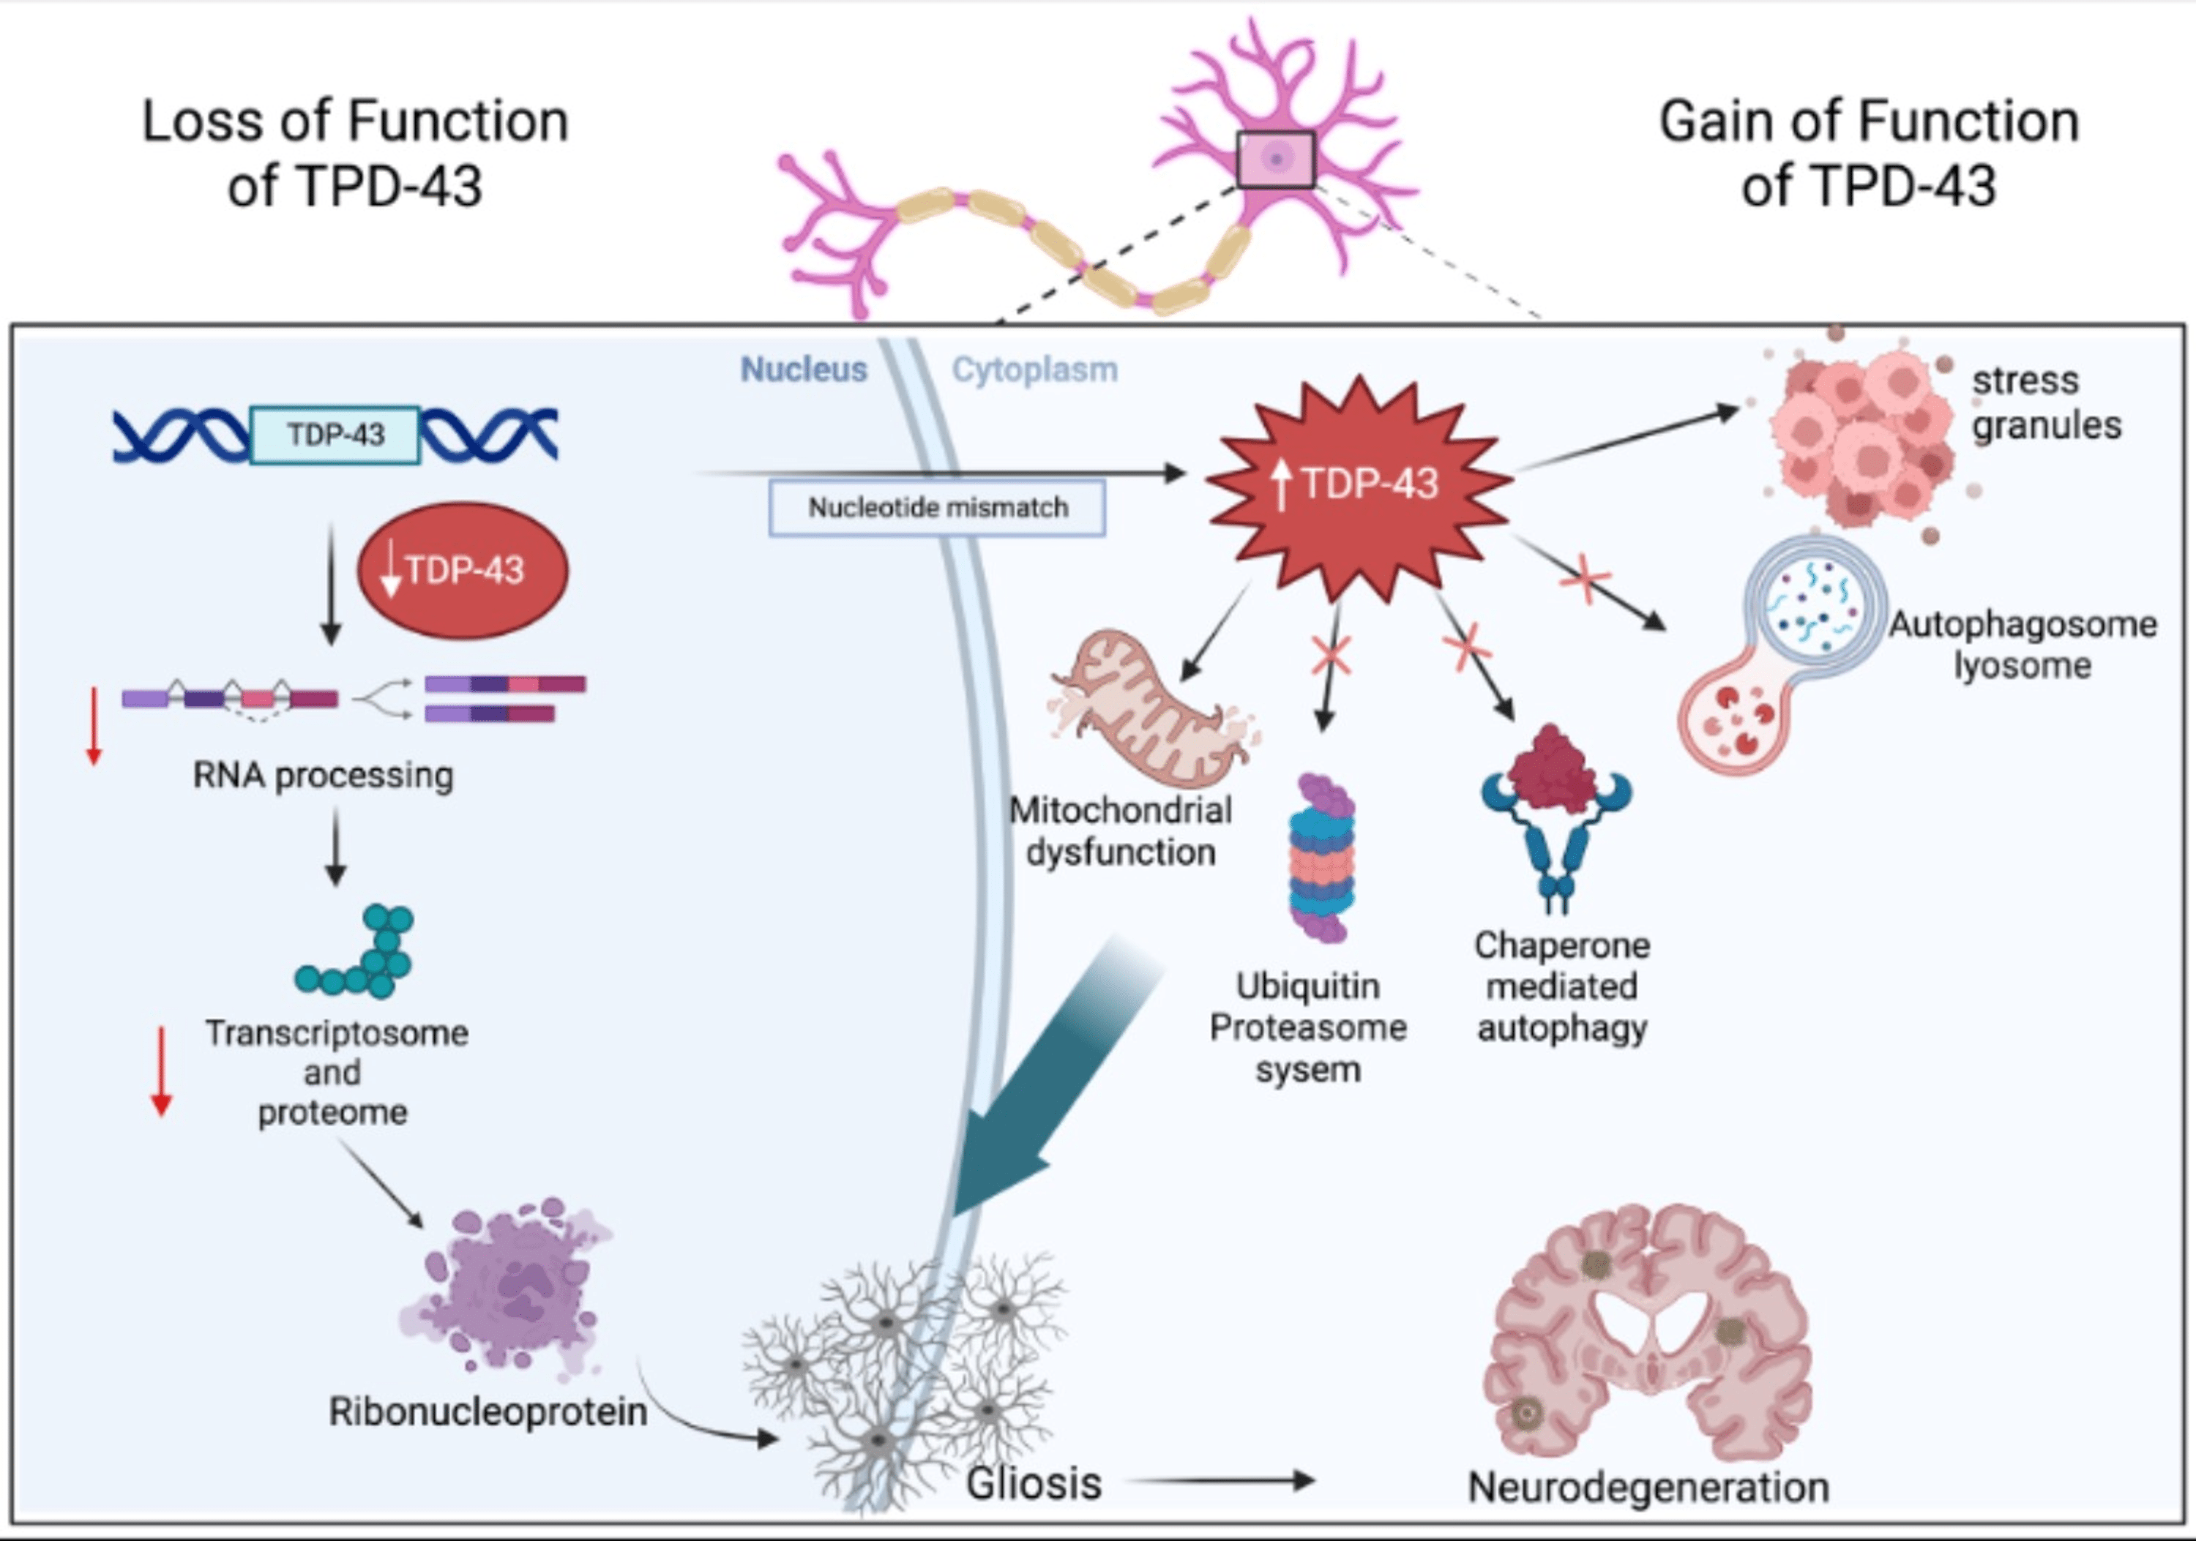
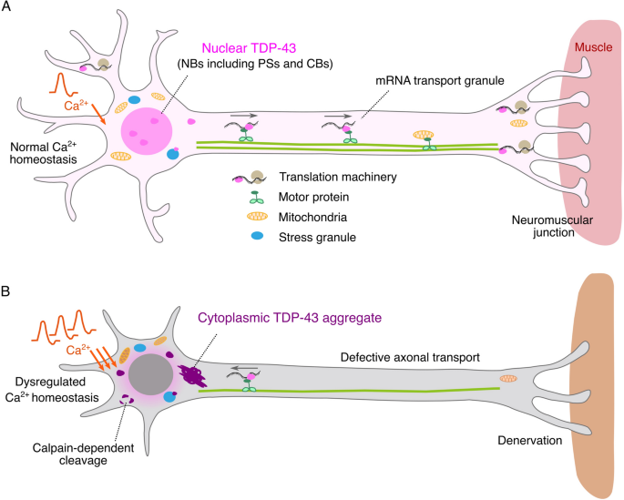
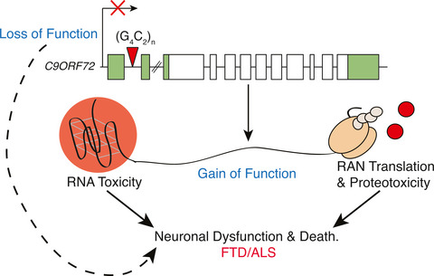
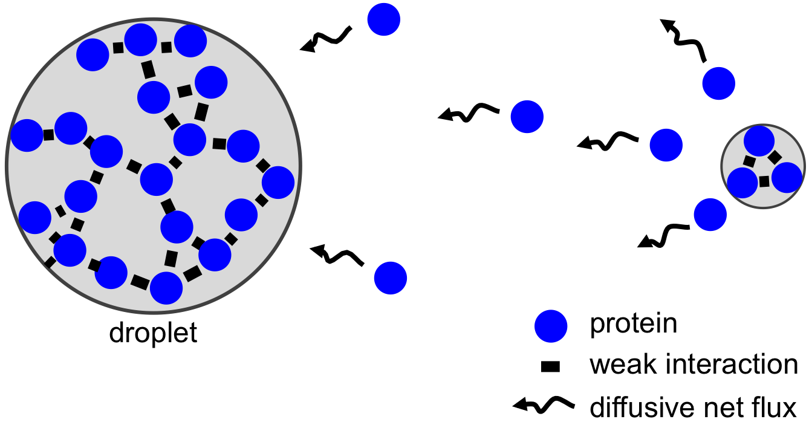
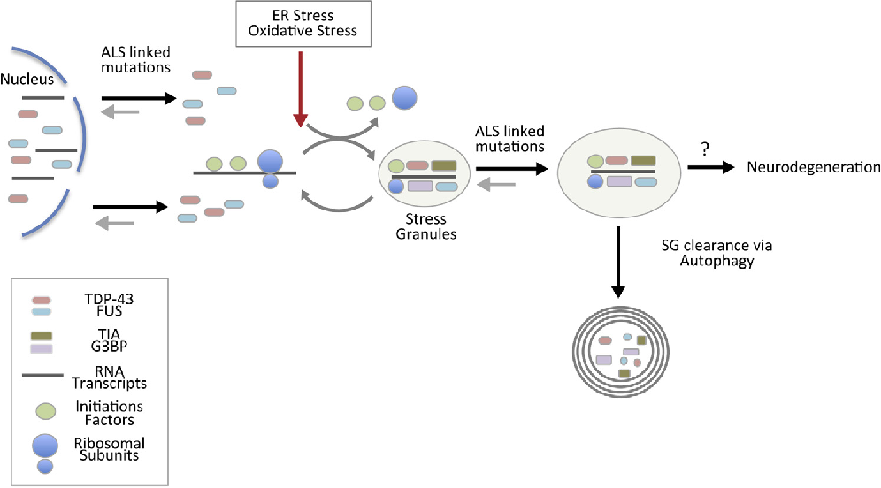
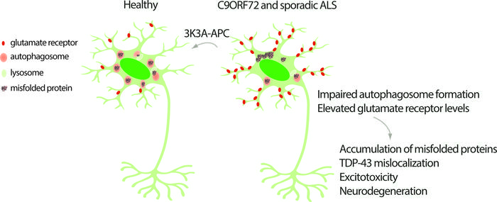
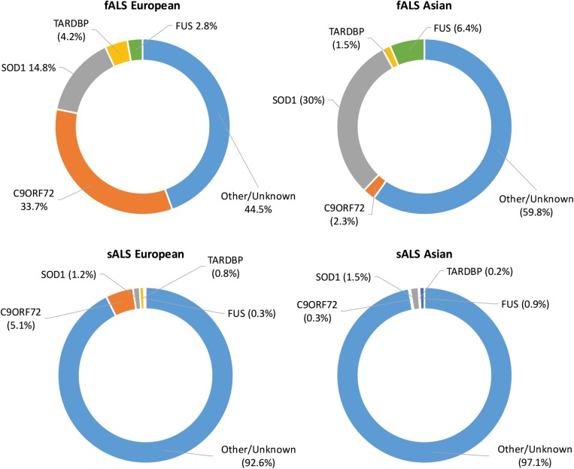
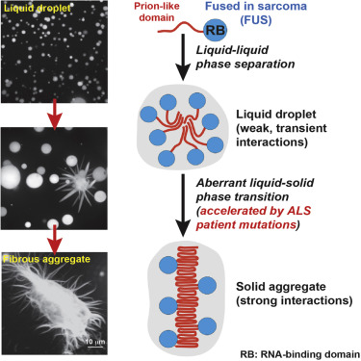
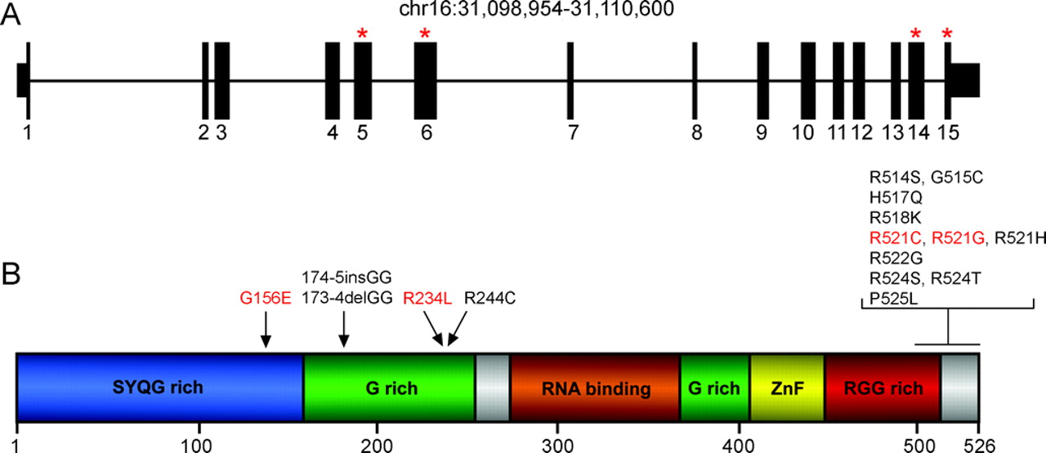
Biomolecular Condensates and Amyotrophic Lateral Sclerosis (ALS)
Jeeva Gill
Department of Biological Sciences
Supervisor: Dr. Don Nelson
What are Biomolecular Condensates
TDP-43
C9ORF72
Biomolecular condensates are dynamic, liquid-like assemblies formed by the reversible, multivalent interactions between two or more types of molecules, typically proteins or nucleic acids. These condensates can form spontaneously, driven by a balance of attractive and repulsive forces between molecules, and can be highly dynamic, changing in size, composition, and shape over time. Biomolecular condensates are increasingly recognized as important regulators of a variety of cellular processes, including gene expression, signaling, and membrane trafficking. They are thought to function by locally concentrating and organizing molecules, creating microenvironments that promote specific biochemical reactions or signal transduction events.
TDP-43 (TAR DNA-binding protein 43) is a protein that plays a critical role in the regulation of gene expression and RNA metabolism. It binds to specific sequences of DNA and RNA known as TAR elements and regulates the processing, stability, and translation of RNA. TDP-43 is also known to be involved in the formation of nuclear bodies, which are structures within the cell where RNA metabolism takes place.
In normal cells, TDP-43 is localized primarily in the nucleus. However, in patients with Amyotrophic lateral sclerosis (ALS), TDP-43 is found to be mislocalized and aggregated in the cytoplasm of affected cells, particularly in the motor neurons of the spinal cord and brain. This abnormal behavior of TDP-43 is thought to contribute to the degeneration of these cells, leading to the symptoms of ALS.
C9ORF72 is a gene that has been linked to several neurodegenerative diseases, including amyotrophic lateral sclerosis (ALS). The mutation in this gene involves an expansion of a hexanucleotide repeat (GGGGCC) in the non-coding region, which can lead to the formation of abnormal RNA foci and dipeptide repeat proteins (DPRs).
Recent studies have suggested that C9ORF72 mutations can also affect the behavior of biomolecular condensates in cells. In particular, it has been shown that the dipeptide repeat proteins produced by the expansion can localize to and disrupt the behavior of several types of condensates, including stress granules and nucleoli.
Biomolecular Condensates and ALS
FUS
Biomolecular condensates have been linked to the pathogenesis of amyotrophic lateral sclerosis (ALS), a progressive neurodegenerative disease that affects nerve cells in the brain and spinal cord, leading to muscle weakness, paralysis, and eventually death. ALS is characterized by the accumulation of abnormal protein aggregates, in affected neurons.
FUS (Fused in Sarcoma) is a RNA-binding protein that is known to form liquid-like biomolecular condensates in cells. These condensates are thought to play important roles in regulating RNA processing and other cellular functions, such as DNA damage repair and transcriptional regulation.
Mutations in the FUS gene have been linked to several neurodegenerative diseases, including amyotrophic lateral sclerosis (ALS). These mutations can disrupt the normal behavior of FUS in biomolecular condensates, leading to the accumulation of abnormal protein aggregates and the dysregulation of RNA metabolism.
Acknowledgments
I would like to thank Dr. Don Nelson and the TRU Faculty of Science for their continued support and encouragement.
Ayala, Y. M., Zago, P., D'Ambrogio, A., Xu, Y. F., Petrucelli, L., Buratti, E., & Baralle, F. E. (2008). Structural determinants of the cellular localization and shuttling of TDP-43. Journal of cell science, 121(Pt 22), 3778–3785. https://doi.org/10.1242/jcs.038950
Chia, R., Chiò, A., & Traynor, B. J. (2018). Novel genes associated with amyotrophic lateral sclerosis: diagnostic and clinical implications. The Lancet. Neurology, 17(1), 94–102. https://doi.org/10.1016/S1474-4422(17)30401-5
Fernandopulle, M., Wang, G., Nixon-Abell, J., Qamar, S., Balaji, V., Morihara, R., & St George-Hyslop, P. H. (2019). Inherited and Sporadic Amyotrophic Lateral Sclerosis and Fronto-Temporal Lobar Degenerations arising from Pathological Condensates of Phase Separating Proteins. Human molecular genetics, 28(R2), R187–R196. https://doi.org/10.1093/hmg/ddz162
Lagier-Tourenne, C., Baughn, M., Rigo, F., Sun, S., Liu, P., Li, H. R., Jiang, J., Watt, A. T., Chun, S., Katz, M., Qiu, J., Sun, Y., Ling, S. C., Zhu, Q., Polymenidou, M., Drenner, K., Artates, J. W., McAlonis-Downes, M., Markmiller, S., Hutt, K. R., … Ravits, J. (2013). Targeted degradation of sense and antisense C9orf72 RNA foci as therapy for ALS and frontotemporal degeneration. Proceedings of the National Academy of Sciences of the United States of America, 110(47), E4530–E4539. https://doi.org/10.1073/pnas.1318835110

