Slide 1
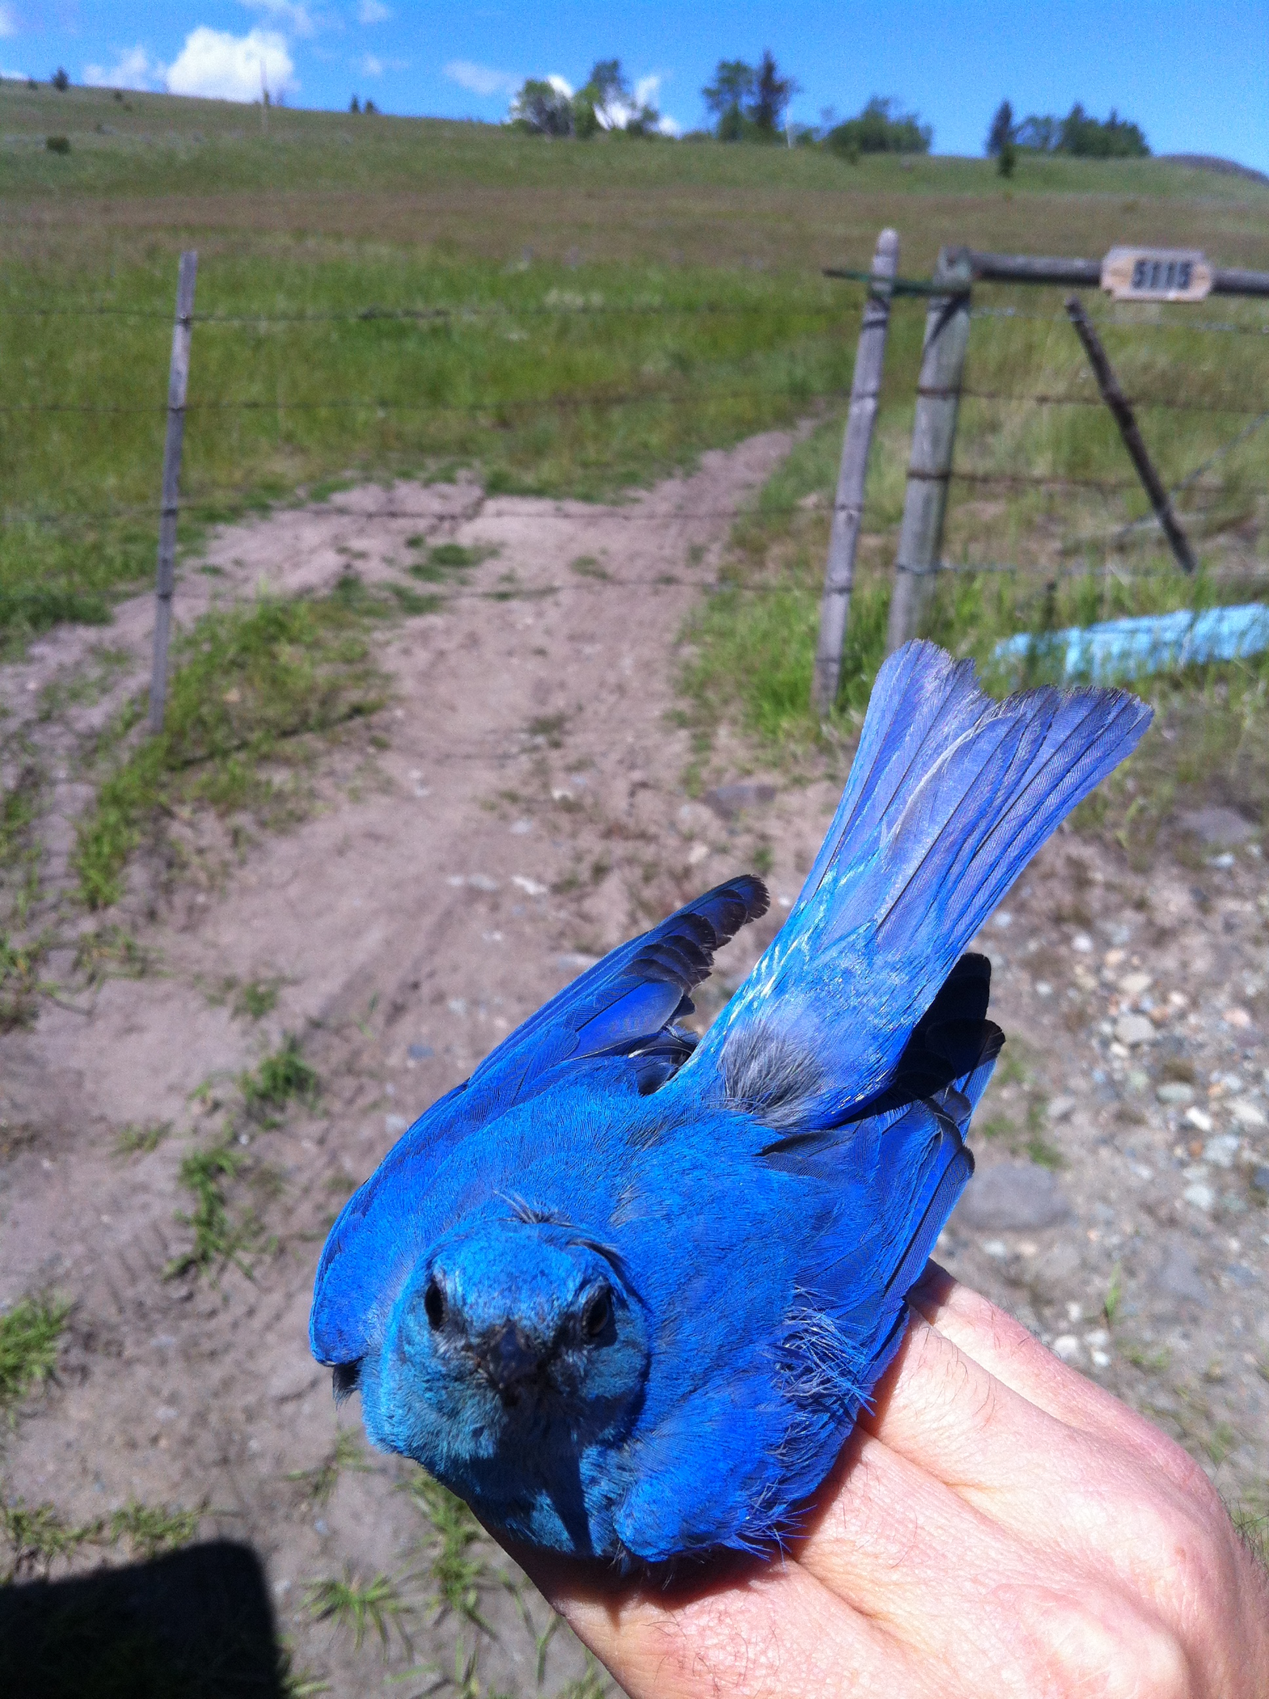
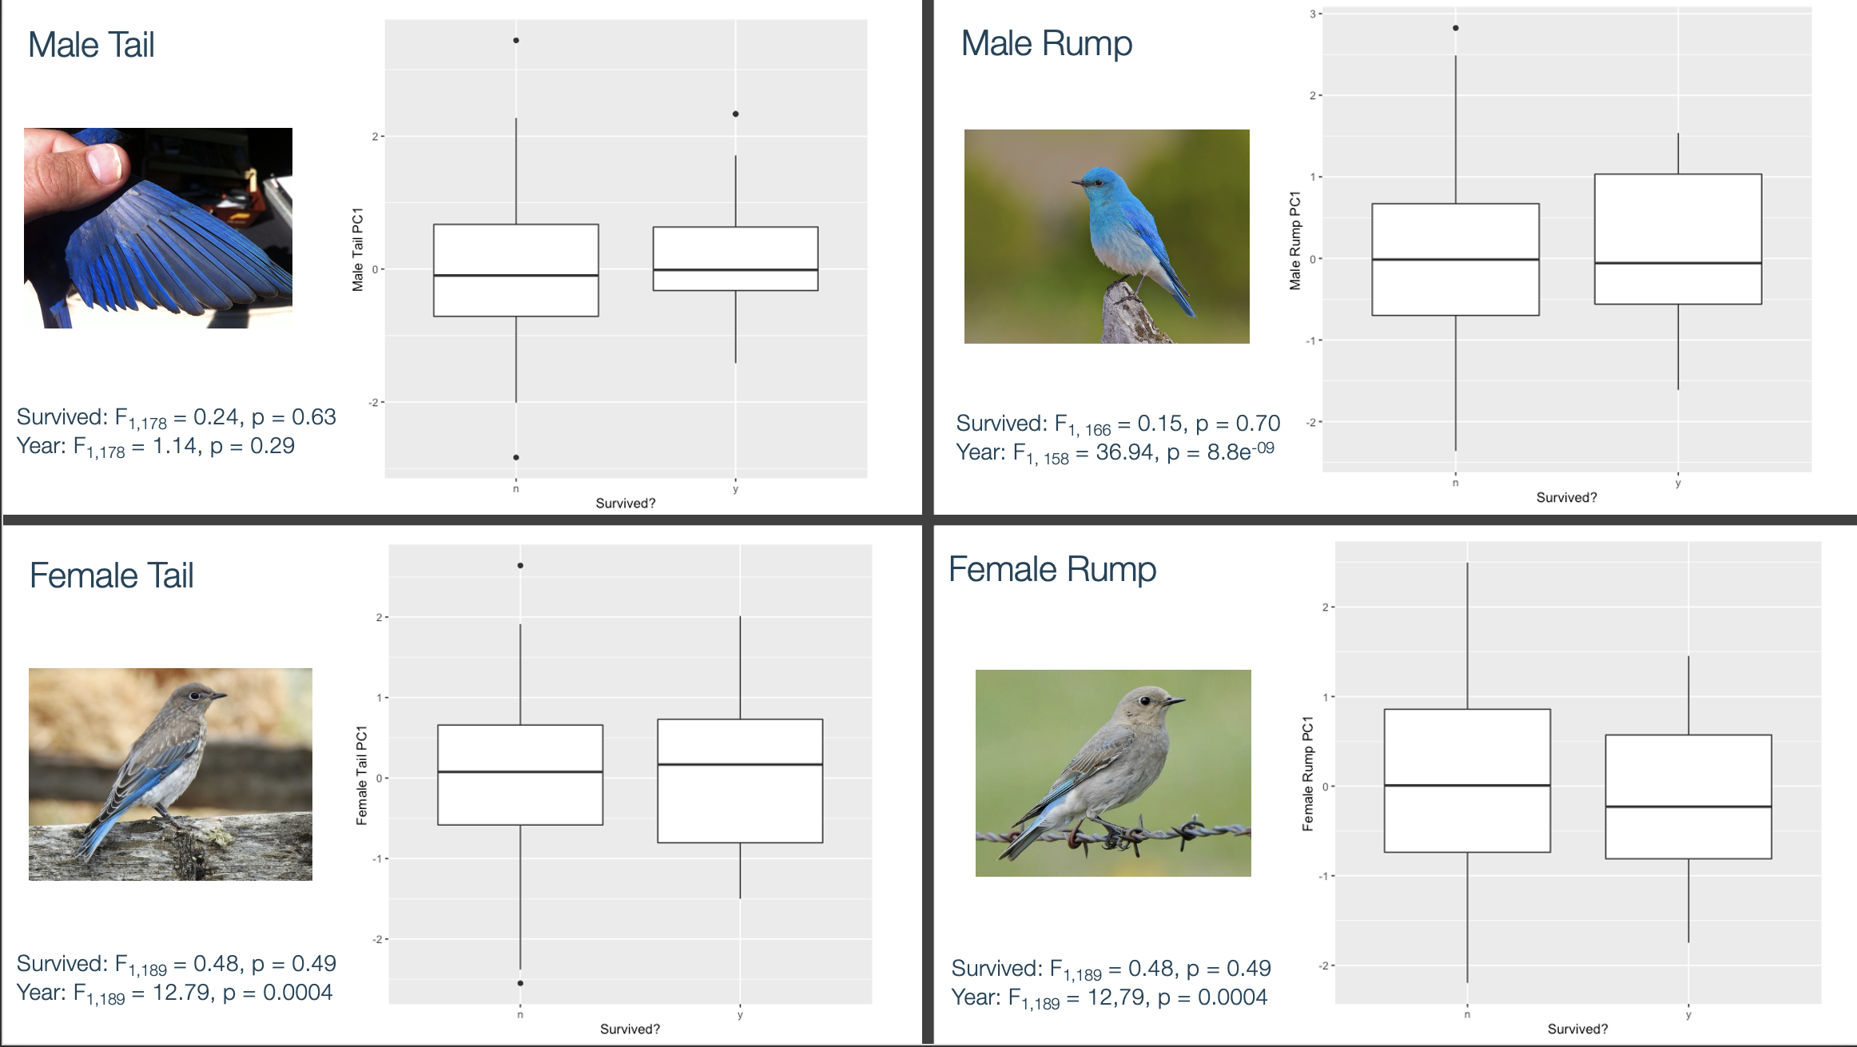
Is Brightness Related to Survival in Male and Female Mountain Bluebirds?
Colourful birds are not more likely to survive than muted birds
Department of Biological Sciences
METHODS
Jeeva Gill
Tail and rump (body) feathers collected from 264 ASY (after second year) birds ranging from 2011-2019
UV-blue colouration of feathers analyzed using reflectance spectrometry
Calculated values for hue, chroma, and brightness for each feather
Collapsed 3 variables using principal component analysis (PCA), giving us a single variable, PC1, that describes the overall brightness of the birds within each gender
Supervisor: Dr. Matthew Reudink Co-supervisor: Dr. Nancy Flood
INTRODUCTION
Mountain Bluebirds (Sialia currucoides) are small migratory songbirds that reside in western North America. Mountain Bluebirds have incredibly colourful UV-blue colouration that is directly related to individual condition. The species exhibits sexual dichromatism, with males having more vibrant UV-blue colouration than females. Plumage plays a large role in mate choice, since colourful feathers can communicate individual condition and thus quality to potential mates.
FURTHER RESEARCH
We plan to analyze the heavy metal content of feathers on which colour analysis was performed to determine if of the concentration of different heavy metals affects colouration of the feathers. We will also examine whether the concentration of the chemicals present in the feathers plays a role in a bird's survival rate.
GOAL
To determine if birds with brighter plumage have a higher survival rate than those with more muted colouration.
REFERENCES
Balenger, Susan & Johnson, L. & Brubaker, Jessica & Ostlind, Emilene. (2007). Parental Effort in Relation to Structural Plumage Coloration in the Mountain Bluebird (Sialia currucoides). Ethology. 113. 838 - 846. 10.1111/j.1439-0310.2007.01386.x.
Balenger, S.L., Johnson, L.S. & Masters, B.S. Sexual selection in a socially monogamous bird: male color predicts paternity success in the mountain bluebird, Sialia currucoides . Behav Ecol Sociobiol 63, 403 (2009). https://doi.org/10.1007/s00265-008-0674-5

